Slide 1

Parcel project
Emir Açikgöz
George Ottens
Ismail Böyükşimşek
Laurine Stolpe
Rick Hagenaar
Idriss Bensaga

Slide 2
Introduction
Rick Hagenaar
Emir Açikgöz
George Ottens
Ismail Böyükşimşek
Laurine van de Stolpe
Idriss Bensaga

Slide 3
Content
Recap
Predicting time series
Model implementation
Planning
Questions

Slide 4

Recap
Product owner: PostNL
Assignment: Predicting the amount of processed packages
Data: amount of daily packages processed, for 300 customers

Slide 5
Predicting timeseries
2 Different kinds of models:
Autoregression moving average
Multi Variabele Lineaire Regression

Slide 6
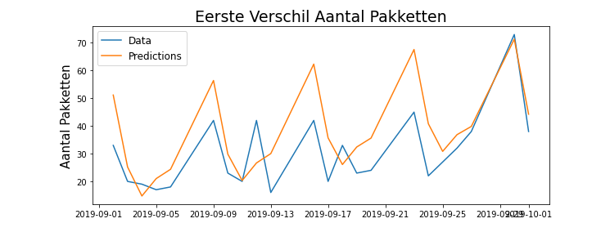
Model implementation
Autoregression Moving Avarage model
Predictions for September 2019
Notes:
- The first 3 weeks of September are used to make a prediction for the last week of September. The graph shows the actual and predicted change in the amount of packages, according to the day before.

Slide 7
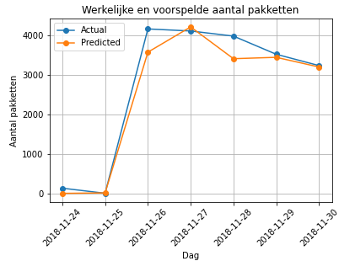
Model implementation
Multi Variabele Lineaire Regression
Prediction for the last week of November 2018
Root Mean Squared Error: 318.13378967805477 R2 score: 0.9656203094322737
Notes:
- The first 3 weeks of September are used to make a prediction for the last week of September. The graph shows the actual and predicted change in the amount of packages, according to the day before.

Slide 8
What we will do for the next week
ARMA ---> SARIMA
Features

Slide 9

Questions

